Slide 1

EnvironmentalMonitorinG
Name: A Sakthivel
Reg no:713921106045
Emailid:sakthivel08022002@gmail.com

Slide 2
IoT-based Environmental Monitoring System is designed to analyze the adverse consequences that happened in the environment and generate corresponding awareness from the upcoming energetic young graduates.
Internet of Things (IoT)
A complete kit is modeled to monitor environmental variations and it is integrated with Internet of Things (IoT) for global accessing of users via internet. Arduino is a microcontroller having the benefits of low cost and minimum power, which is present to aggregate the sensor data and transmit towards IoT devices via Wi-Fi module.

Slide 3
Major Hardware devices Used
Input Components
-Temperature sensor – LM 35
-Humidity sensor – ESP 8266
-Arduino UNO microcontroller
-Power supply
Communication Interfaces
-Wired USB Connectors
-Wireless Fidelity (Wi-Fi) module
Output Components
-IoT device – smart phone
-LCD (Optional)
Major Software Used
Arduino IDE

Slide 4
The recent innovative projects handled by our team under the model of IoT-based Environmental Monitoring System
Analysis of developed Environmental monitoring System also on different locations
Smart monitoring to assist farmers also for minimizing the level of greenhouse gases using environmental monitoring system
Arduino and also Cayenne based environmental monitoring system over Internet of Things
Measurement of environmental conditions over a particular campus using Wireless sensor Network and also Arduino

Slide 5
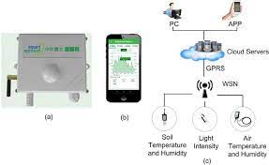
Block Diagram

Slide 6
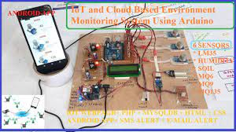

Slide 7
Arduino-Projects:
Arduino UNO is used also for modeling an efficient design of periodical moisture monitoring system
Weather conditions as temperature and also humidity are monitored using Arduino UNO platform
Global System for Mobile Communication also for alerting the environment based on the environmental changes
ESP 8266 sensor in environmental monitoring system integrated with Internet of Things also using Wi-Fi modem
Robot based environmental monitoring system also in different areas
Monitoring of industries weather conditions also to avoid unnecessary damage
Instant SMS alert message over a combination of wired and also wireless framework
Identification of the effects of global warming also using IoT-based Environmental Monitoring System
Measurement of heat conditions also over the location of deployed solar cells

Slide 8
Iot-based Environmental Projects
Wireless Sensor Networks deployed on Urban Areas also for monitoring environmental weather status
An economical pollution monitoring system also based on Internet of Things
A monitoring system for indoor environment also using Internet of Things environment
Using Arduino for designing a greenhouse environment and also alerting emergency via Global System modem
A smart environmental monitoring system designed also using wireless sensor network with Internet of Things
Monitoring wastage exhausted over the environment also using IoT with Arduino
Pollution and humidity monitoring using advanced sensors also for accurate sensing reports
A public environmental monitoring system also to create safety aware future generations
Remote environmental weather monitoring also using significant sensors
Natural hazardous alert system to protect living beings also using Internet of Things environment
Environmental Monitoring System also using IoT over Agricultural environment
Monitoring of indoor air quality to generate countermeasures also for minimizing pollution if any present
Internet of Things enabled monitoring systems also using low cost sensor devices

